Slide 1
Understanding Dbt Build: Executing Seeds, Snapshots, Models, and Tests in DAG Dependency Order
Efficient data transformations with correct execution sequence
Notes:
AI-generated content may be incorrect. --- This presentation covers the essential aspects of the dbt build process, including executing seeds, snapshots, models, and tests in the correct DAG dependency order to ensure efficient and reliable data transformations.

Slide 2

Agenda Overview
Introduction to Dbt and Its Build Workflow
Detailed Breakdown of Dbt Build Components
Tests in Dbt: Ensuring Data Quality at Every Step
Executing Dbt Build in DAG Dependency Order
Practical Applications and Benefits of Dbt Build
Notes:
--- We will begin with an introduction to dbt and its build workflow, then explore the core components of dbt build. Next, we'll focus on the role of tests in maintaining data quality, followed by how dbt executes builds respecting DAG dependencies. Finally, we will discuss practical applications and benefits of dbt build. Image source: Microsoft 365 content library

Slide 3
Introduction to Dbt and Its Build Workflow
Notes:
Understanding dbt's purpose and how its build workflow orchestrates the execution of data transformations and quality checks is fundamental. We'll also learn about the Directed Acyclic Graph (DAG) concept and why it is critical in dbt.

Slide 4

Overview of Dbt (Data Build Tool) and Its Purpose
Modular SQL Development
Dbt allows analytics engineers to write modular SQL code that is reusable and easy to maintain across data projects.
Data Pipeline Automation
Dbt automates data transformation pipelines, reducing manual work and improving reliability in analytics workflows.
Software Engineering Best Practices
Dbt applies software engineering principles to analytics, promoting testing, version control, and documentation.
Notes:
--- Dbt is a command-line tool that enables analytics engineers to transform data in their warehouses by writing modular SQL and automating data pipeline processes. It focuses on software engineering best practices for analytics. Image source: Microsoft 365 content library

Slide 5
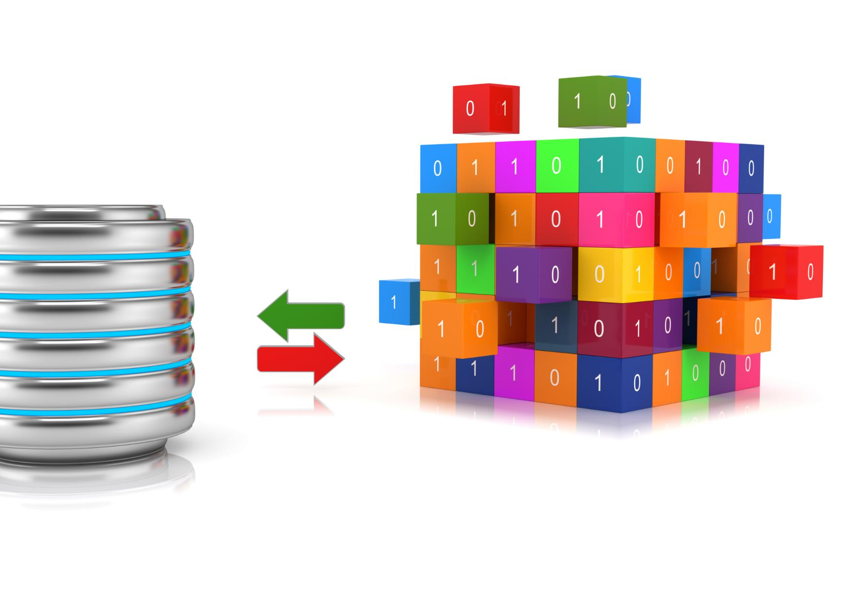
Key Dbt Build Components: Seeds, Snapshots, Models, Tests
Seeds for Static Data
Seeds load static data into the data warehouse, providing foundational datasets for transformations.
Snapshots for Slowly Changing Data
Snapshots capture historical states of data, managing slowly changing data over time.
Models as SQL Transformations
Models perform SQL transformations to shape raw data into meaningful analytical tables.
Tests for Data Quality
Tests validate data accuracy and consistency, ensuring pipeline data quality and reliability.
Notes:
--- Dbt build consists of several components: seeds for loading static data, snapshots for capturing slowly changing data, models as SQL transformations, and tests to ensure data quality throughout the pipeline. Image source: Microsoft 365 content library

Slide 6

What Is DAG (Directed Acyclic Graph) and Why It Matters in Dbt
DAG Definition
A directed acyclic graph represents dependencies with no cycles between nodes or tasks.
Role in dbt
DAG ensures dbt task execution in a logical, cycle-free order for correct data model builds.
Notes:
--- The DAG is a structure representing dependencies between dbt resources, ensuring tasks run in a logical order without cycles. This allows dbt to build data models efficiently and correctly. Image source: Microsoft 365 content library

Slide 7
Detailed Breakdown of Dbt Build Components
Notes:
We will now delve deeper into each dbt build component: seeds, snapshots, and models, understanding their roles and how they fit into the overall data transformation workflow.

Slide 8

Understanding Seeds: Static Data Loading
Definition of Seeds
Seeds are CSV files used in dbt to load static data into data warehouses as tables.
Purpose of Seeds
They provide static reference data crucial for data transformations, including lookup tables and mappings.
Notes:
--- Seeds are CSV files that dbt loads into the data warehouse as tables. They provide static reference data essential for transformations, such as lookup tables or mappings. Image source: Microsoft 365 content library

Slide 9

Introduction to Snapshots: Capturing Slowly Changing Dimensions
Purpose of Snapshots
Snapshots preserve historical states of records to track changes over time effectively.
Application in Data Warehouses
Snapshots are crucial for managing slowly changing dimensions in data warehouse environments.
Notes:
--- Snapshots allow tracking changes in data over time by capturing and preserving historical states of records, which is especially useful for slowly changing dimensions in data warehouses. Image source: Microsoft 365 content library

Slide 10

Exploring Models: SQL Transformations and Logic
Definition of Models
Models in dbt are SQL select statements used to transform raw or intermediate data into refined datasets.
Purpose of Models
Models create analytics-ready tables or views, facilitating modular and maintainable data workflows.
Notes:
--- Models in dbt are SQL select statements that transform raw or intermediate data into refined, analytics-ready tables or views, enabling modular and maintainable data workflows. Image source: Microsoft 365 content library

Slide 11
Tests in Dbt: Ensuring Data Quality at Every Step
Notes:
Testing is integral to dbt's workflow to maintain data reliability. We will examine types of tests, how they are defined and executed, and their role in continuous data validation.

Slide 12

Types of Dbt Tests: Generic, Singular, Schema
Generic Tests
Generic tests are reusable validations applicable across multiple datasets to ensure consistent data quality.
Singular Tests
Singular tests are custom SQL queries tailored to validate specific data conditions or business rules.
Schema Tests
Schema tests enforce data constraints like uniqueness and null value checks to maintain data integrity.
Notes:
--- Dbt supports generic tests (reusable validations), singular tests (custom SQL tests), and schema tests that check constraints like uniqueness or null values to guarantee data integrity. Image source: Microsoft 365 content library

Slide 13

How Tests Are Defined and Run Within a Build
Test Declaration in YAML
Tests are defined in YAML files to clearly specify test parameters and scenarios for automated execution.
Execution During Build
Tests run automatically during the build process to validate changes and ensure software quality.
Early Failure Detection
Test failures highlight issues early, allowing quick fixes and maintaining clean data pipelines.
Notes:
--- Tests are declared in YAML files and executed during the build process. Failures highlight issues early, enabling quick corrections and ensuring clean data pipelines. Image source: Microsoft 365 content library

Slide 14

Role of Tests in Maintaining Pipeline Reliability
Continuous Data Validation
Tests constantly check data quality to ensure only accurate information passes through the pipeline.
Preventing Data Corruption
Testing helps detect and block corrupt or unexpected data from advancing further in the workflow.
Ensuring Trustworthy Analytics
Reliable tests maintain confidence in analytics outputs for better data-driven decision-making.
Notes:
--- By continuously validating data, tests prevent corrupt or unexpected data from progressing, thus maintaining trust in analytics outputs and enabling reliable decision-making. Image source: Microsoft 365 content library

Slide 15
Executing Dbt Build in DAG Dependency Order
Notes:
Proper execution order in dbt respects resource dependencies defined in the DAG, ensuring that seeds, snapshots, models, and tests run in the correct sequence for consistent results.

Slide 16
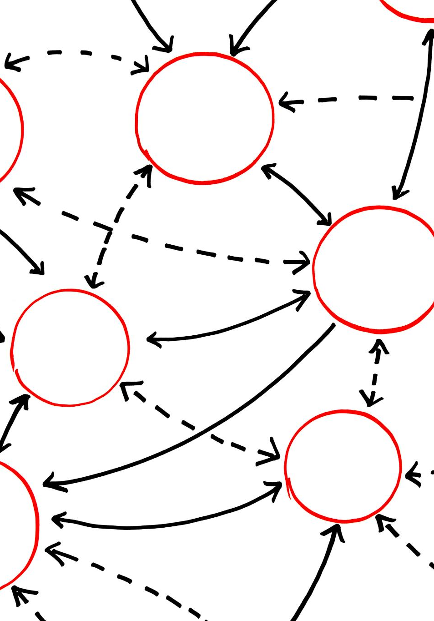
How Dbt Builds and Executes Resources in Dependency Order
Dependency Analysis via DAG
Dbt uses Directed Acyclic Graphs to map resource dependencies before execution begins.
Ordered Resource Execution
Resources are built only after all dependent resources have been successfully executed.
Error Prevention and Optimization
This method prevents errors and improves pipeline performance by optimizing build order.
Notes:
--- Dbt analyzes the DAG to determine execution order, building resources only after their dependencies are satisfied, preventing errors and optimizing pipeline performance. Image source: Microsoft 365 content library

Slide 17
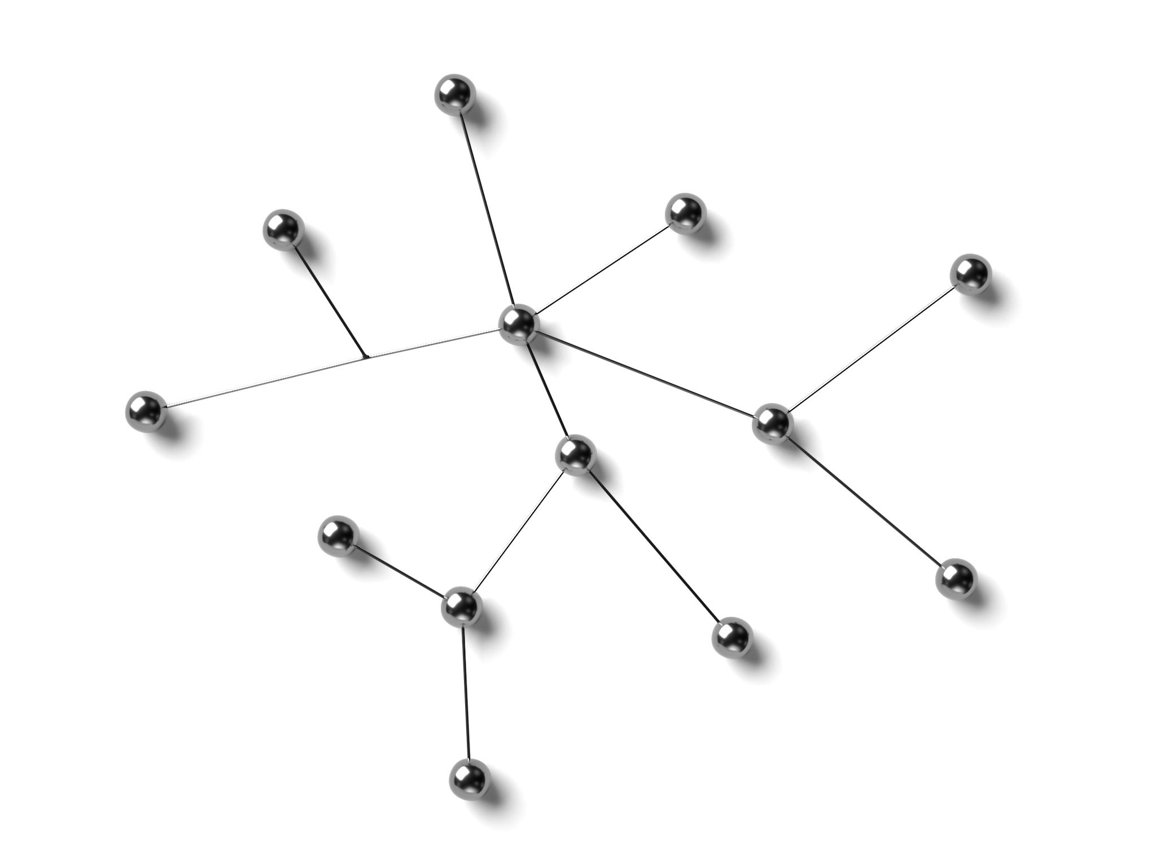
Visualizing and Troubleshooting the DAG in Dbt
Graphical DAG Visualization
Dbt offers commands to display the DAG graphically for easier understanding of the build process.
Understanding Dependencies
Visual DAG representation helps users comprehend dependencies between models in their data workflow.
Identifying Bottlenecks
Visualization assists in spotting issues or bottlenecks that affect the efficiency of the build process.
Notes:
--- Dbt provides commands to visualize the DAG graphically, helping users understand dependencies and identify issues or bottlenecks within their build process. Image source: Microsoft 365 content library

Slide 18
Best Practices for Managing Dependencies and Optimizing Builds
Logical Model Organization
Arrange models systematically to ensure clear structure and streamlined workflows.
Minimize Unnecessary Dependencies
Reduce dependencies to avoid complexity and improve build efficiency.
Use Incremental Models
Leverage incremental building to speed up processes and enhance maintainability.
Notes:
--- Organizing models logically, minimizing unnecessary dependencies, and leveraging incremental models help optimize build times and maintainability. Image source: Microsoft 365 content library

Slide 19
Practical Applications and Benefits of Dbt Build
Notes:
Let's explore how dbt build enhances data pipeline efficiency, fosters collaboration, and see real-world examples of its application in analytics engineering teams.

Slide 20
Improving Data Pipeline Efficiency and Transparency
Automated Execution Order
Dbt build automates the sequence of data pipeline tasks, ensuring correct execution flow without manual intervention.
Reduced Manual Errors
Automation reduces human errors in execution, increasing reliability and data accuracy in pipelines.
Enhanced Pipeline Transparency
Dbt build makes pipelines more transparent, simplifying maintenance and auditing processes.
Notes:
--- Dbt build automates execution order and testing, reducing manual errors, making pipelines more transparent and easier to maintain and audit. Image source: Microsoft 365 content library

Slide 21
Facilitating Collaboration in Analytics Engineering Teams
Modular Approach Benefits
Dbt's modular design allows teams to break projects into manageable parts, promoting efficiency and teamwork.
Version Control Integration
Integration with version control systems enables seamless collaboration and better tracking of changes among team members.
Enhanced Productivity and Sharing
Together, modularity and version control foster knowledge sharing and boost overall team productivity in analytics engineering.
Notes:
--- Dbt's modular approach and version control integration empower teams to work together seamlessly, enhancing productivity and knowledge sharing. Image source: Microsoft 365 content library

Slide 22

Real-World Examples of Dbt Build Workflow in Action
Effective Data Transformation
Dbt build workflows streamline complex data transformation processes, improving efficiency and consistency in data projects.
Faster Delivery Times
Implementing dbt workflows enables organizations to deliver analytical data faster by automating repetitive tasks and reducing errors.
Improved Data Quality
Dbt workflows enhance data quality by enforcing testing and documentation throughout the data transformation lifecycle.
Notes:
--- Many organizations have successfully implemented dbt build workflows to manage complex data transformations, achieving faster delivery and higher data quality. Image source: Microsoft 365 content library

Slide 23
Conclusion
Importance of Dependency Order
Executing dbt build in dependency order ensures reliable and maintainable data pipelines.
Best Practices for Data Quality
Following best practices in dbt leads to improved data quality and analytics efficiency.
Notes:
Understanding dbt build and its execution in dependency order is crucial for building reliable, maintainable data pipelines. Adopting best practices ensures data quality and efficiency for analytics success.

Slide 24
dbt build = (seeds + snapshots + models + tests) run in DAG (dependency) order.
1
Loads & Parses Project
2
Builds a dependency graph
3
Selects nodes (--select/--exclude)
4
Compiles SQL (macros, Jinja, refs)
5
Executes nodes by materialization on your warehouse, with concurrency
6
Runs tests after their upstream nodes
7
Writes artifacts (manifest, run_results) to target

Slide 25
dbt build = (seeds + snapshots + models + tests) run in DAG (dependency) order.
Loads & Parses Project
Builds a dependency graph
Selects nodes (--select/--exclude)
Compiles SQL (macros, Jinja, refs)
Executes nodes by materialization on your warehouse, with concurrency
Runs tests after their upstream nodes
Writes artifacts (manifest, run_results) to target

Slide 26
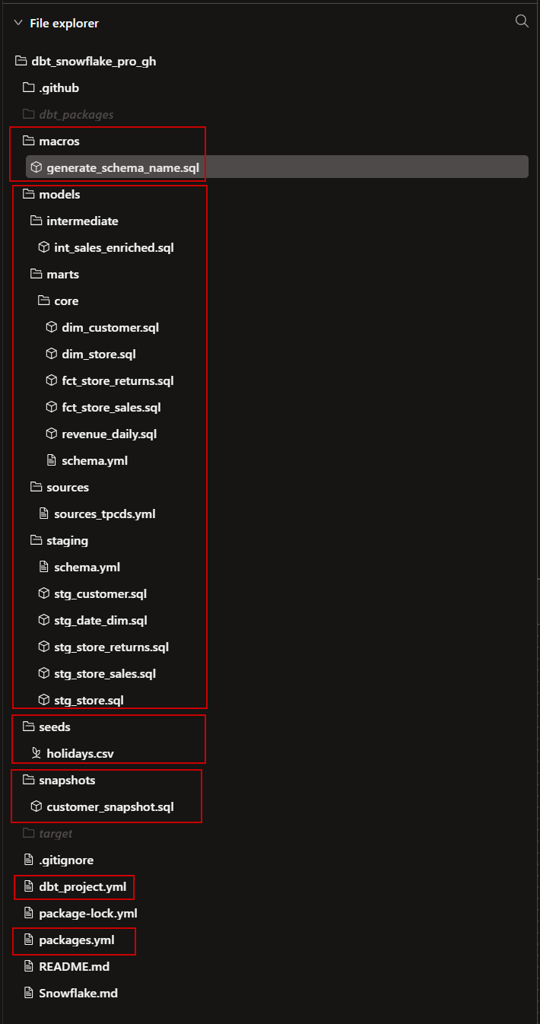
1) Load & parse the project
Reads dbt_project.yml, packages.yml, all models/*, macros/*, snapshots/*, tests/*, seeds/*.
Expands Jinja, loads macros (including adapter-specific ones for Snowflake),
interprets config() blocks, vars, and env vars.
Resolves ref() and source() to fully-qualified relations using your adapter (database, schema naming rules, and—if you overrode it—generate_schema_name).
👉 Snowflake note: If you use a macro like generate_schema_name, dbt computes names like DEV__stg, DEV__mart here, so every relation is consistently targeted.

Slide 27
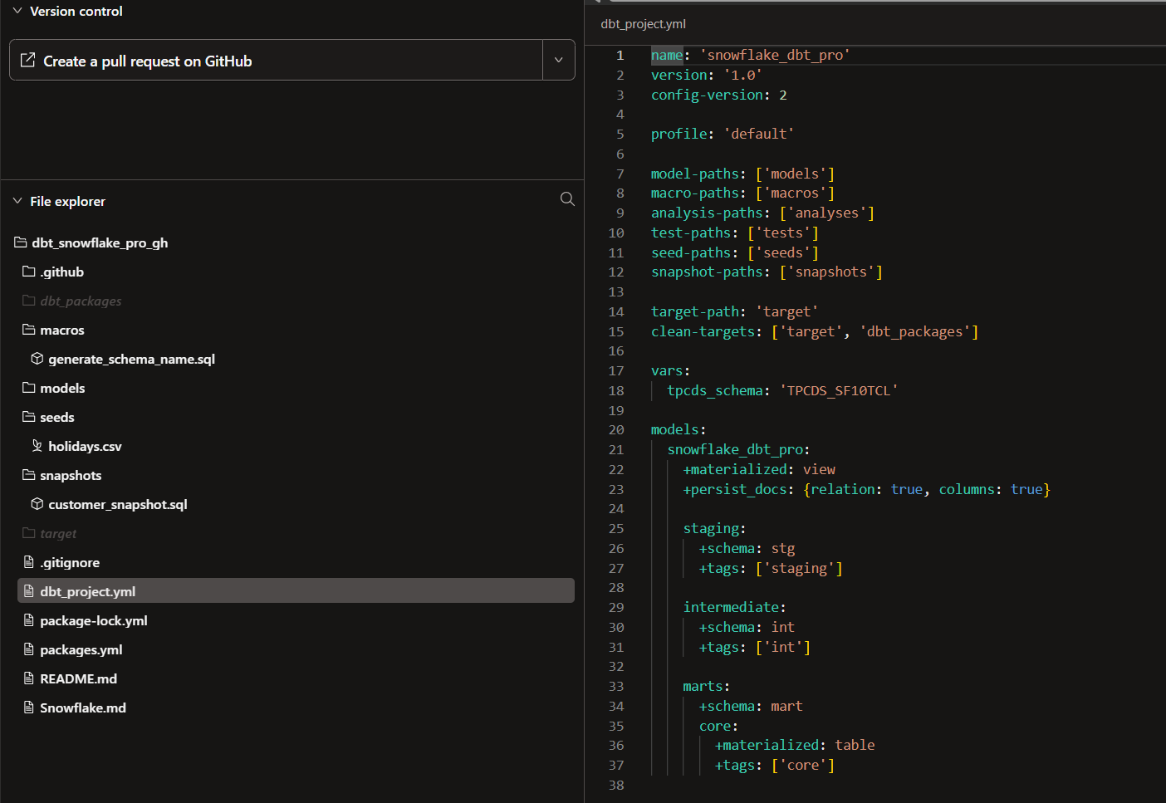
dbt_project.yml

Slide 28
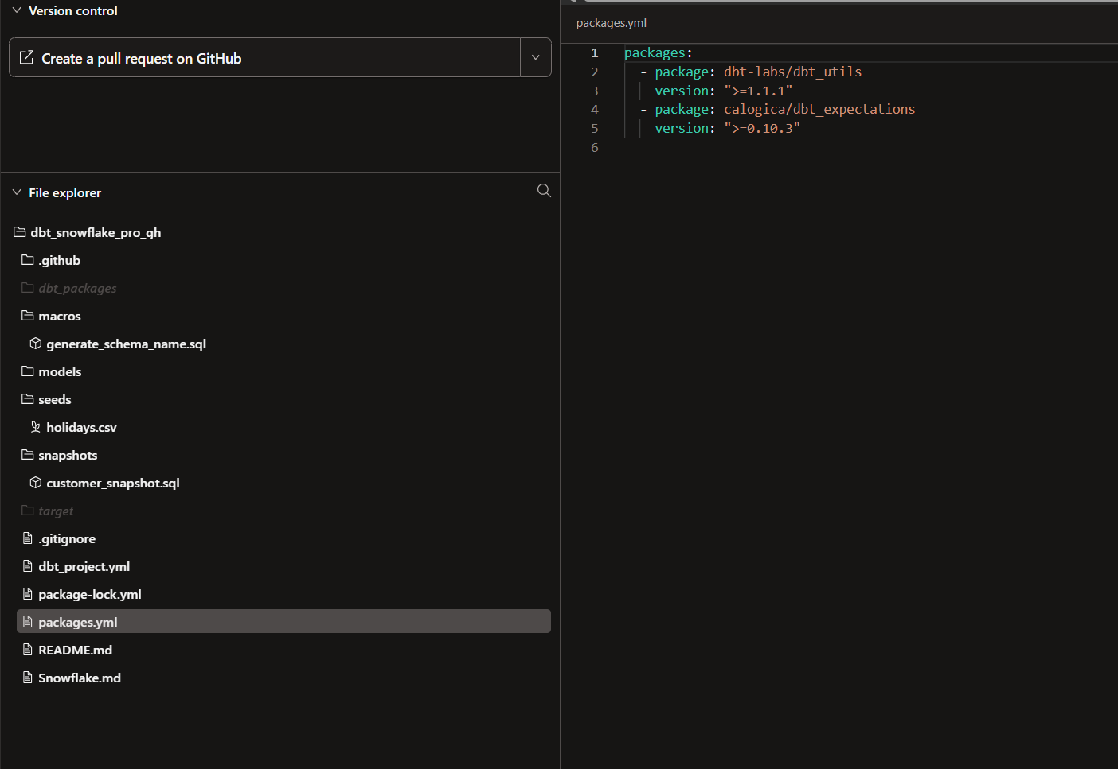
packages.yml

Slide 29
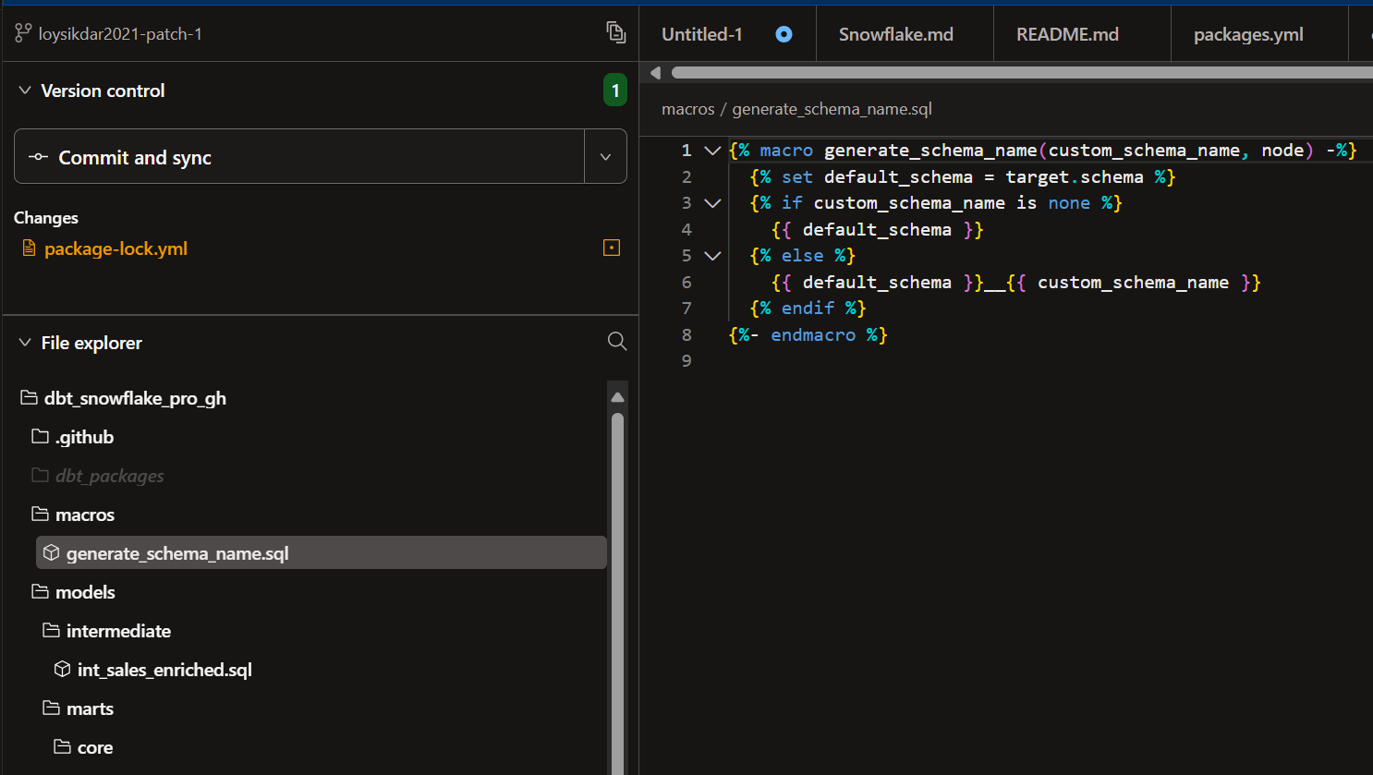
macros – generate_schema_name.sql

Slide 30
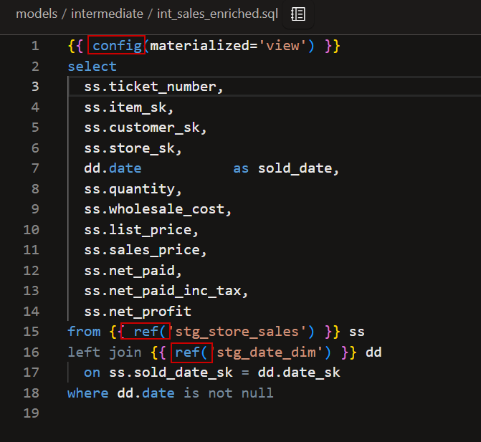
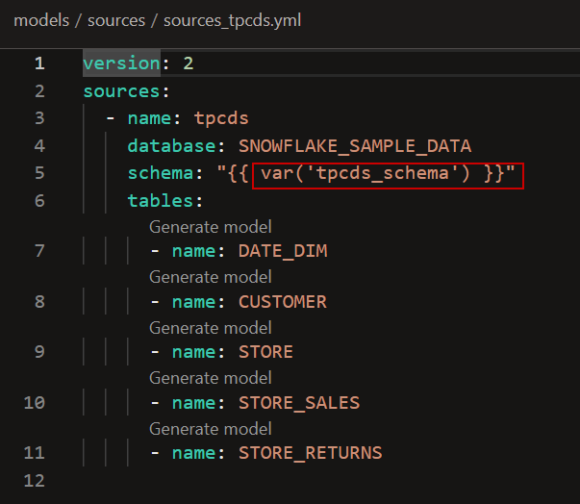
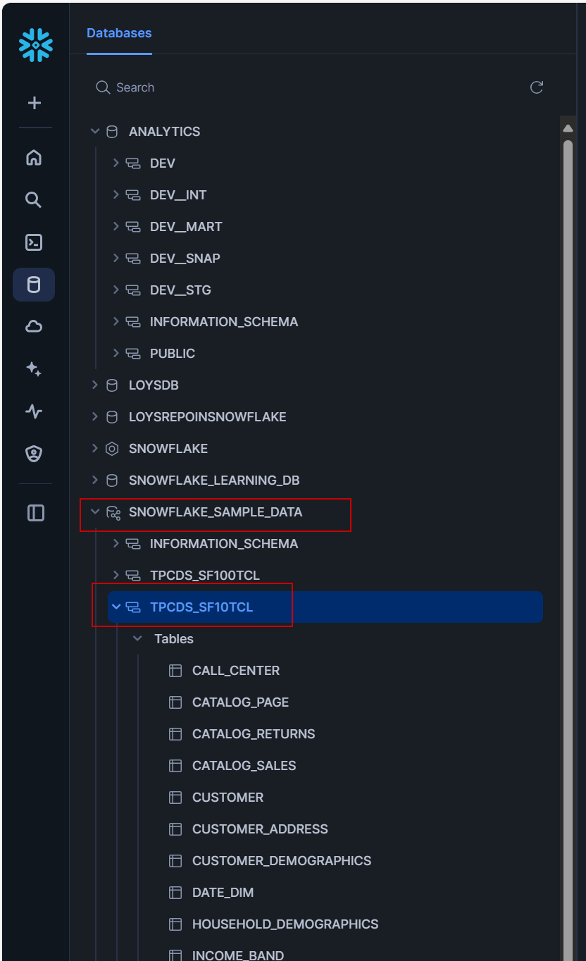
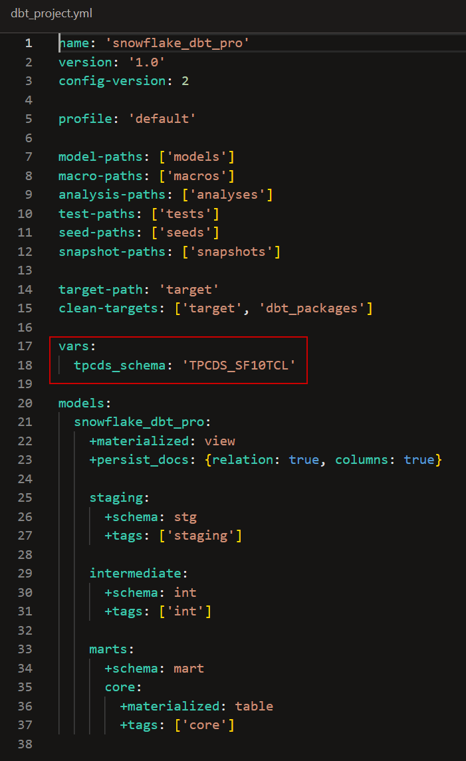
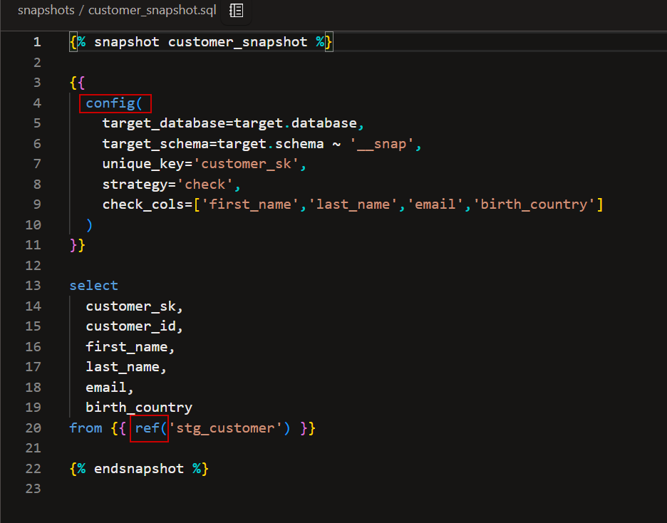
Interprets config() blocks, vars, and env vars.

Slide 31
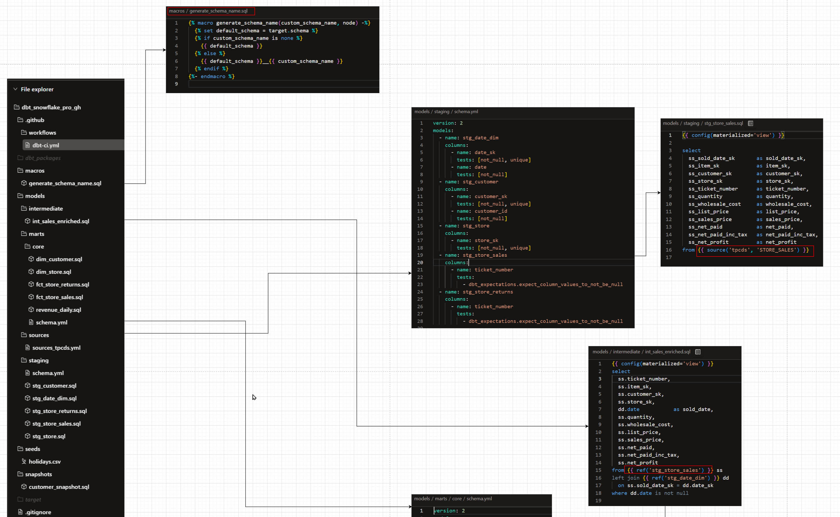
Resolves ref() and source() to fully-qualified relations

Slide 32
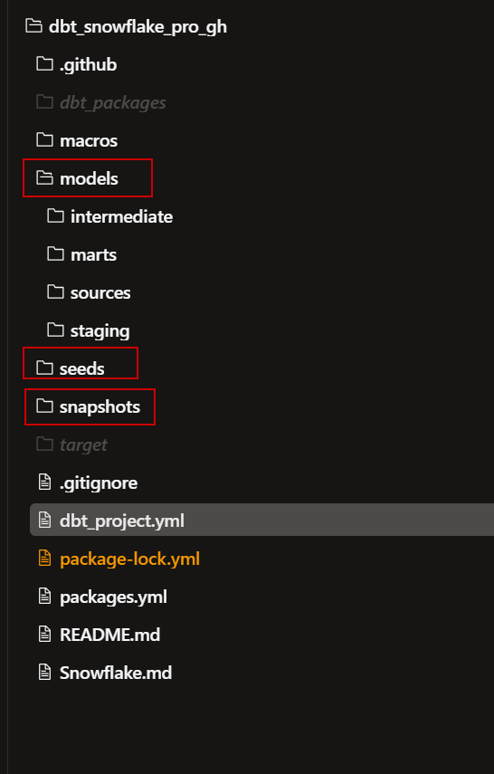
2) Build the DAG (dependency graph)
Nodes = models, snapshots, seeds, tests, etc.
Edges = dependencies from ref()/source() and test dependencies.
dbt stores this “plan” in memory (and outputs it later in manifest.json).

Slide 33
3) Node selection
Applies
--select/--exclude rules,
state selection (state:modified+),
tags,
paths, etc.
Result = the subset of nodes to run this command.

Slide 34
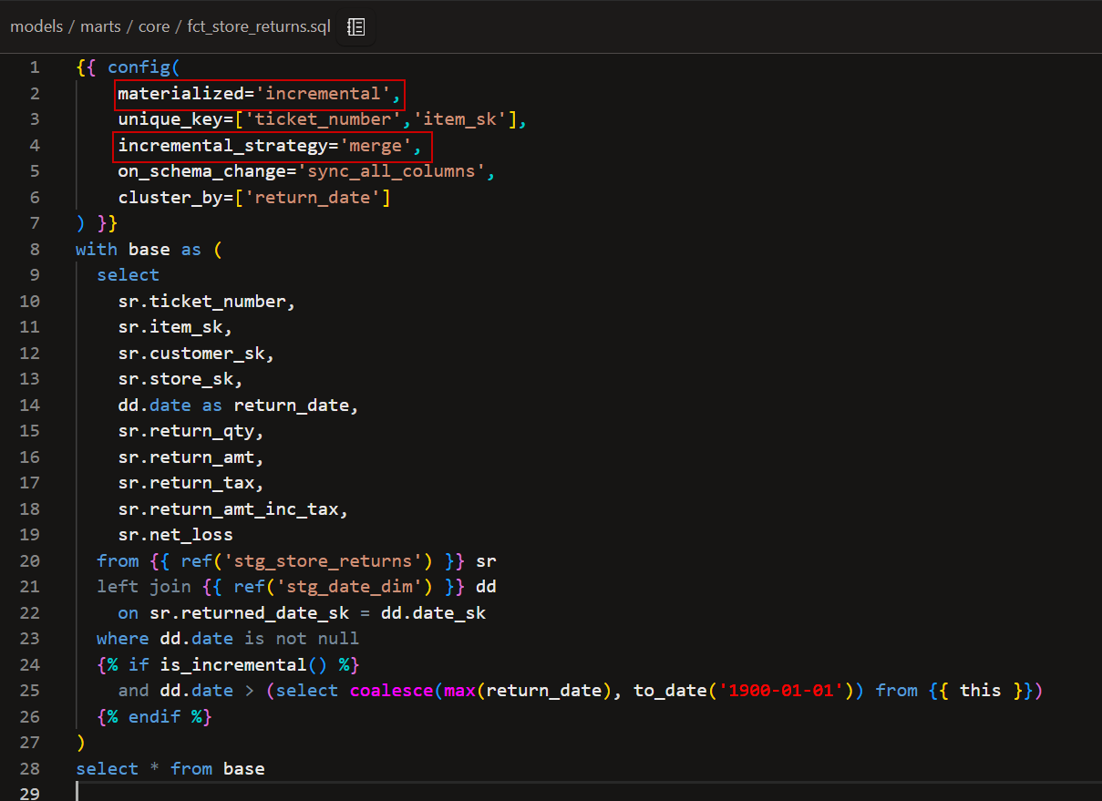
4) Compilation (turn Jinja into SQL)
Renders each node’s SQL with macros, config, conditionals (e.g., is_incremental()), and adapter dispatch.
Ephemeral models are inlined as CTEs into dependents (no standalone relation).
Tests compile to SQL that returns “failing” rows. Success = 0 rows.
👉 Snowflake note:
Materializations come from adapter macros (e.g., view, table, incremental (merge)).
dbt will emit Snowflake-flavored SQL (e.g., create or replace view …, merge into …).

Slide 35
5) Execute in DAG order with concurrency
dbt walks the graph topologically and executes in parallel up to threads (your project profile / Cloud job).
If a node fails, downstream nodes don’t run. Unrelated branches may continue (unless --fail-fast).
Execute in DAG order with concurrency
Seeds (CSV ➔ tables)
Snapshots (SCD)
Models (Materialization)
Tests

Slide 36
5) Execute in DAG order with concurrency
Execute in DAG order with concurrency
Seeds (CSV → tables) | Snapshots (SCD) | Models (materializations) | Tests (always after builds)
dbt seed phase: creates/replaces tables and loads CSVs with types inferred/overridden. Downstream models can safely depend on them. | dbt snapshot logic runs: compares current rows to previously snapshotted rows. Strategies: timestamp, check, etc. Writes to snapshot schema (e.g., DEV__snap). Often used to add history for dims like customer. | view: create or replace view <schema>.<name> as (<compiled select>). table: create or replace table as select … (full rebuild). incremental (Snowflake default strategy = merge): First run: create table from the full select. Subsequent runs: dbt evaluates your is_incremental() guards, then: Stages a temp table with new/changed rows (based on your filters, e.g., date > max(date) in target). Executes a merge into <target> using <staging> on (<unique_key>) when matched then update … when not matched then insert …. Honors options like on_schema_change (e.g., sync_all_columns) and cluster_by. ephemeral: inlined CTEs in the parent model; no database object created. 👉 Snowflake tips for incremental Always declare a reliable unique_key. Use a deterministic filter for is_incremental() (e.g., date/updated_at watermark). Consider cluster_by on large facts for pruning. Keep warehouse on auto-suspend; XSMALL is fine to start. | Generic tests (e.g., not_null, unique, relationships, dbt_expectations): compile to SQL that returns failing rows. Singular tests: custom .sql with a select of failing rows. dbt runs tests after their upstream nodes have materialized. Severity can be warn or error. Failures are recorded with row counts.

Slide 37
6) Hooks & exposures (optional)
on-run-start / on-run-end hooks fire if defined (e.g., logging, session params).
Exposures aren’t executed; they document downstream dependencies (dashboards, apps) and show up in docs/lineage.

Slide 38
7) Artifacts & docs
target/manifest.json — the parsed+compiled project (DAG, nodes, configs)
target/run_results.json — what ran, timing, statuses, errors
target/catalog.json — columns, types (for docs site).You can serve docs with dbt docs generate && dbt docs serve (Cloud shows docs in the UI).
Run 'dbt docs generate' in the command bar in order to view the most recent docs for this project.

Slide 39
dbt_project.yml

